Slide 1
Machine numbers: how floating point numbers are stored?

Slide 2
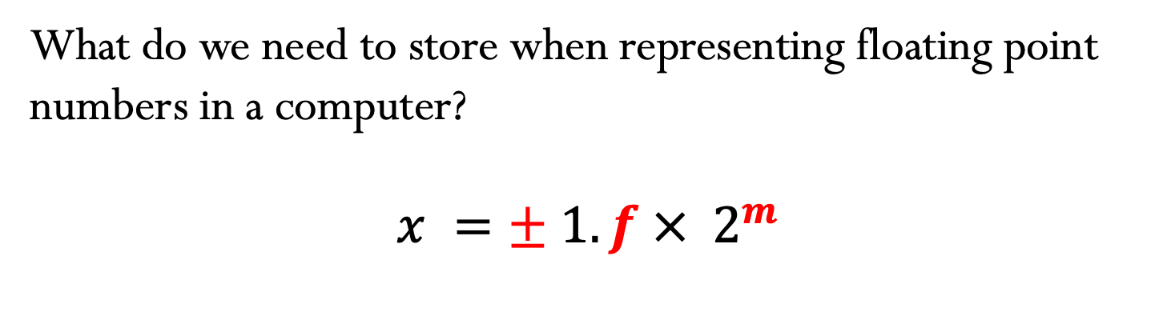
Floating-point number representation
What do we need to store when representing floating point numbers in a computer?
$$x =± 1.f ×{ 2}^{m}$$
Initially, different floating-point representations were used in computers, generating inconsistent program behavior across different machines.
Around 1980s, computer manufacturers started adopting a standard representation for floating-point number: IEEE (Institute of Electrical and Electronics Engineers) 754 Standard.

Slide 3
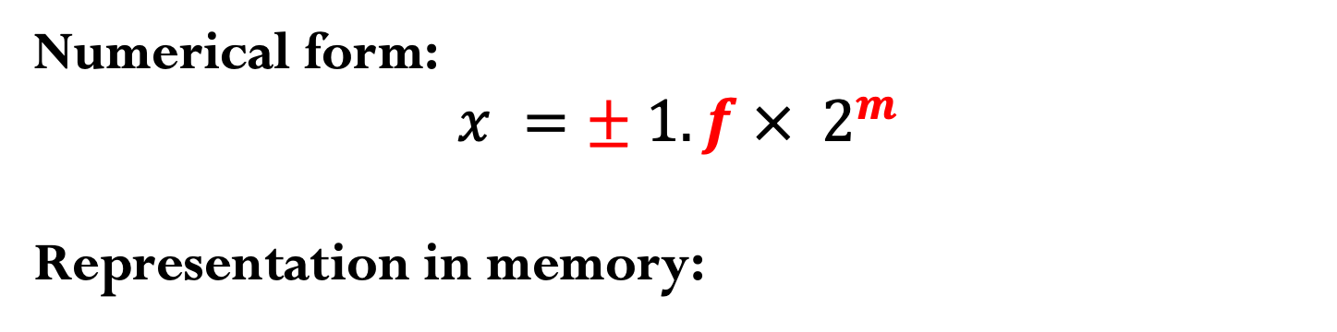
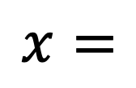
Floating-point number representation
Numerical form:
$$x =± 1.f ×{ 2}^{m}$$
Representation in memory:
$$x=$$
sign
exponent
significand

Slide 4
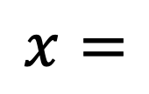

Precisions:
Finite representation: not all numbers can be represented exactly!
$$x =± 1.f ×{ 2}^{c−shift}$$
IEEE-754 Single precision (32 bits):
$$x=$$
IEEE-754 Double precision (64 bits):
$$x=$$

Slide 5
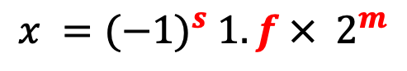




IEEE-754 Single Precision (32-bit)
$$x ={(−1)}^{s} 1.f ×{ 2}^{m}$$
$$m=c−shift$$
$$s$$
$$c$$
$$f$$
sign (1-bit)
exponent
(8-bit)
significand
(23-bit)
Notes:
Store the shifted exponent c = m + 127, so that the sign of the exponent does not need to be stored (exponent can be stored in 8 bits instead of 7).

Slide 6
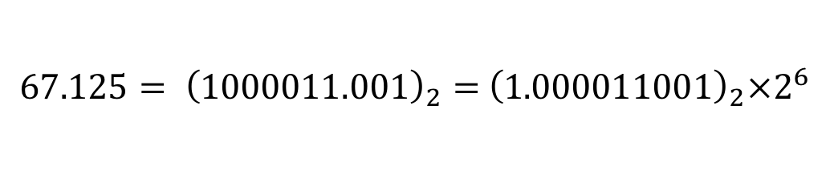
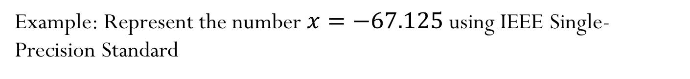
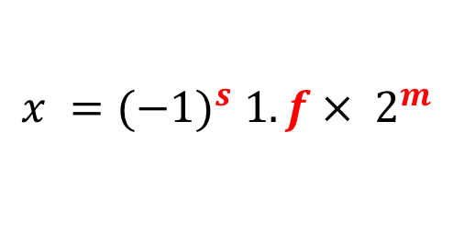
IEEE-754 Single Precision (32-bit)
$$x ={(−1)}^{s} 1.f ×{ 2}^{m}$$
Example: Represent the number $x=−67.125$ using IEEE Single-Precision Standard
$${67.125= \left(1000011.001\right)}_{2}={ \left(1.000011001\right)}_{2}×2^{6}$$

Slide 7

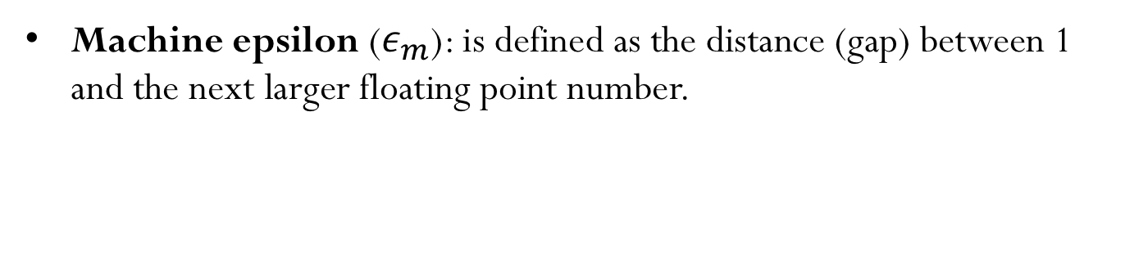


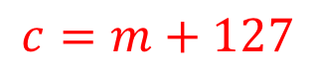
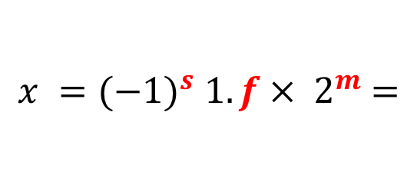
IEEE-754 Single Precision (32-bit)
$$x ={(−1)}^{s} 1.f ×{ 2}^{m} =$$
$$s$$
$$c$$
$$f$$
$$c=m+127$$
Machine epsilon ($ε_{m}$): is defined as the distance (gap) between 1 and the next larger floating point number.
Smallest positive normalized FP number:
Largest positive normalized FP number:
Notes:
Because of machine epsilon, we infer that in a simple computation, approximately six sig figs of accuracy may be obtained in single precision

Slide 8
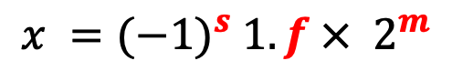
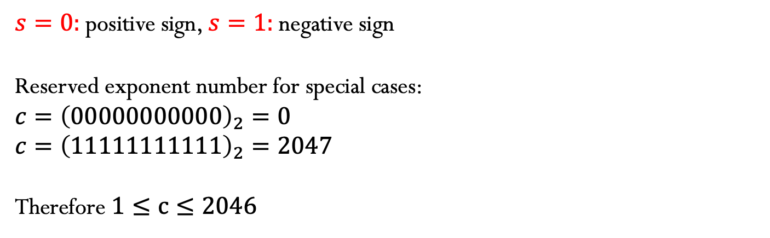

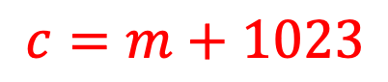

IEEE-754 Double Precision (64-bit)
$$x ={(−1)}^{s} 1.f ×{ 2}^{m}$$
$$s$$
$$c=m+1023$$
$$f$$
sign (1-bit)
exponent
(11-bit)
significand
(52-bit)
$s=0:$positive sign, $s=1:$negative sign
Reserved exponent number for special cases:
$${c=\left(00000000000\right)}_{2}=0$$
$${c=\left(11111111111\right)}_{2}=2047$$
Therefore $1≤c≤2046$

Slide 9

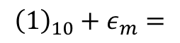
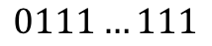

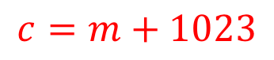
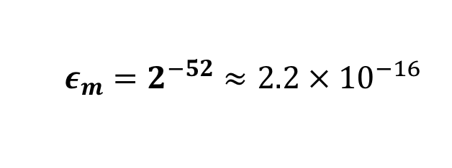
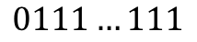
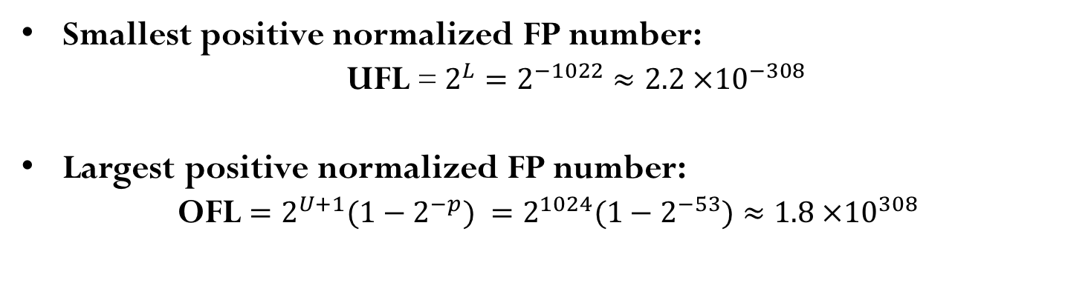
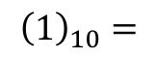
IEEE-754 Double Precision (64-bit)
$$x ={(−1)}^{s} 1.f ×{ 2}^{m} =$$
$$s$$
$$c$$
$$f$$
$$c=m+1023$$
Machine epsilon ($ε_{m}$): is defined as the distance (gap) between 1 and the next larger floating point number.
$${\left(1\right)}_{10}=$$
$$0$$
$$0111…111$$
$$000000000000…000000000$$
$${\left(1\right)}_{10}+ε_{m}=$$
$$0$$
$$0111…111$$
$$000000000000…000000001$$
$$ε_{m}=2^{−52}≈2.2 ×{ 10}^{−16}$$
Smallest positive normalized FP number:
UFL = $2^{L}=2^{−1022}≈2.2 ×{10}^{−308}$
Largest positive normalized FP number:
OFL ${=2^{U+1}(1−2}^{−p})$ ${=2^{1024}(1−2}^{−53})≈1.8 ×{10}^{308}$
Notes:
Because of machine epsilon, we infer that in a simple computation, approximately six sig figs of accuracy may be obtained in single precision

Slide 10


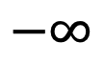
Normalized floating point number scale (single precision)
$$−∞$$
$$+∞$$
$$0$$

Slide 11
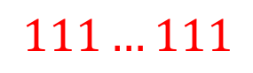



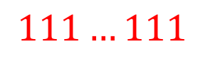

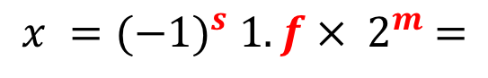
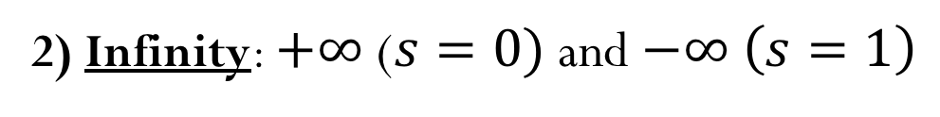

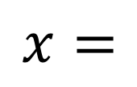
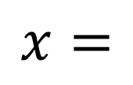

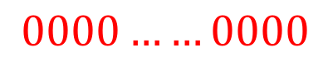
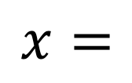
Special Values:
$$x ={(−1)}^{s} 1.f ×{ 2}^{m} =$$
$$s$$
$$c$$
$$f$$
1) Zero:
$$x=$$
$$s$$
$$000…000$$
$$0000……0000$$
2) Infinity: $+∞$($s=0)$ and $−∞ \left(s=1\right)$
$$x=$$
$$s$$
$$111…111$$
$$0000……0000$$
3) NaN: (results from operations with undefined results)
$$x=$$
$$s$$
$$111…111$$
$$anything ≠00…00$$

Slide 12
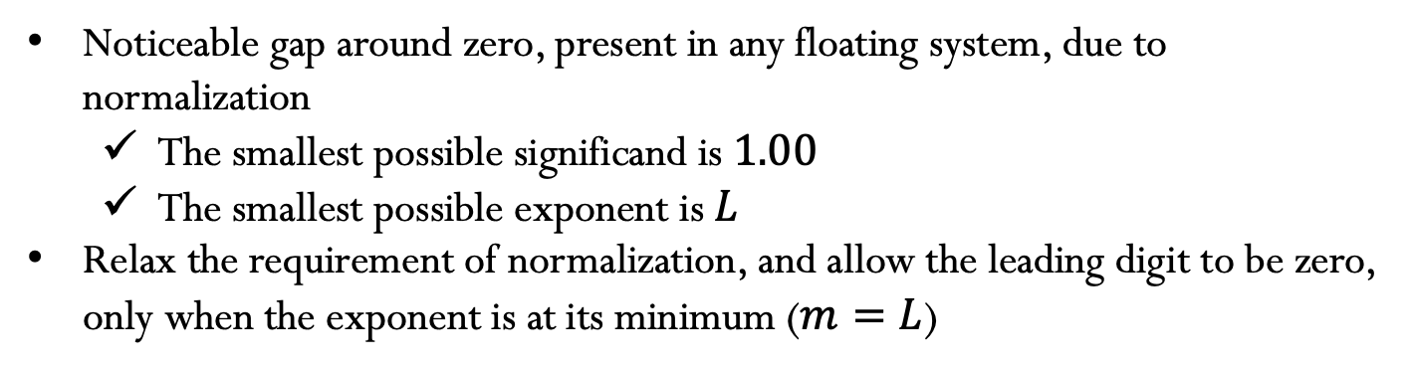
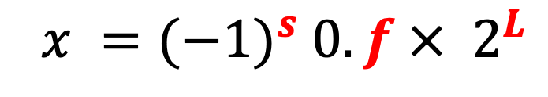
Subnormal (or denormalized) numbers
Noticeable gap around zero, present in any floating system, due to normalization
The smallest possible significand is $1.00$
The smallest possible exponent is $L$
Relax the requirement of normalization, and allow the leading digit to be zero, only when the exponent is at its minimum ($m=L$)
$${ x =(−1)}^{s} 0.f ×{ 2}^{L}$$
Notes:
Why would you want to know about subnormals? Because
computing with them is often slow, because it is implemented
using ‘FP assist’, i.e. not in actual hardware. Many C compilers
support options to ‘flush subnormals to zero’.
Lost of precision when using subnormal numbers
Computations with subnormal numbers are often slow: Subtraction of two non-equal numbers never produces a result of exactly zero.
the smallest gap between two consecutive normalized floating-point number is ϵm⋅UFL, which is the smallest positive subnormal number. This means subtracting two non-equal number will be at least the smallest subnormal number, so it will never produces a result of 0.

Slide 13
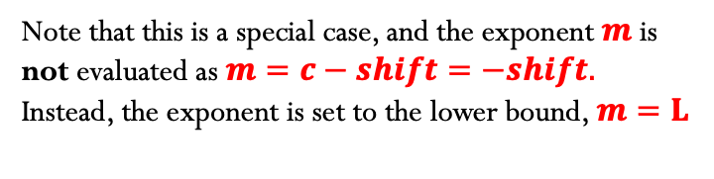

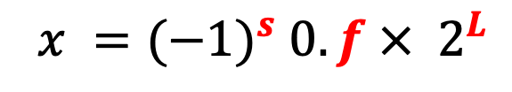
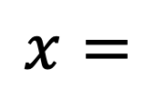

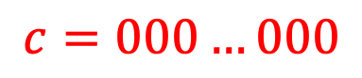
Subnormal (or denormalized) numbers
Another special case:
$$x=$$
$$s$$
$$c=000…000$$
$$f$$
$${ x =(−1)}^{s} 0.f ×{ 2}^{L}$$
Note that this is a special case, and the exponent $m$ is not evaluated as $m=c−shift=−shift.$
Instead, the exponent is set to the lower bound, $m=L$
PROS: More gradual underflow to zero
CONS: - Computations with subnormal numbers are often slow;
- Loss of precision
Notes:
Why would you want to know about subnormals? Because
computing with them is often slow, because it is implemented
using ‘FP assist’, i.e. not in actual hardware. Many C compilers
support options to ‘flush subnormals to zero’.
Lost of precision when using subnormal numbers
Computations with subnormal numbers are often slow: Subtraction of two non-equal numbers never produces a result of exactly zero.
the smallest gap between two consecutive normalized floating-point number is ϵm⋅UFL, which is the smallest positive subnormal number. This means subtracting two non-equal number will be at least the smallest subnormal number, so it will never produces a result of 0.

Slide 14
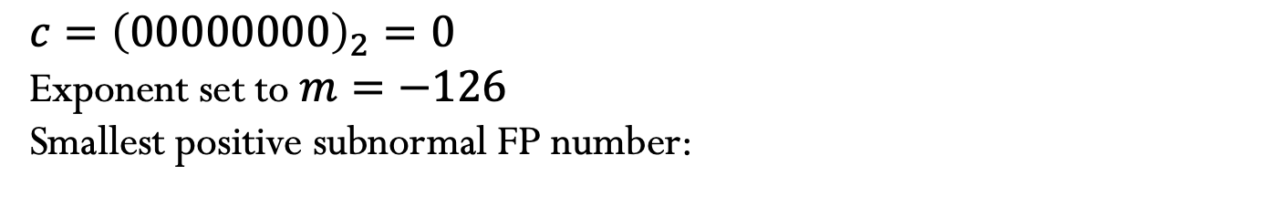
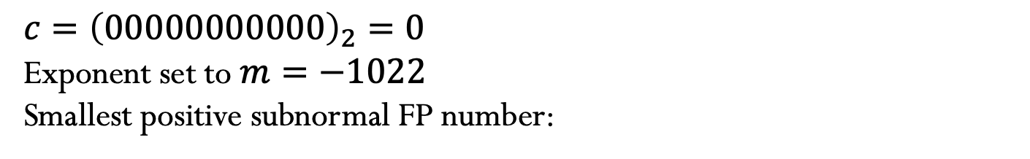
Subnormal (or denormalized) numbers
IEEE-754 Single precision (32 bits):
${c=\left(00000000\right)}_{2}=0$
Exponent set to $m=−126$
Smallest positive subnormal FP number:
IEEE-754 Double precision (64 bits):
${c=\left(00000000000\right)}_{2}=0$
Exponent set to $m=−1022$
Smallest positive subnormal FP number:
Notes:
Why would you want to know about subnormals? Because
computing with them is often slow, because it is implemented
using ‘FP assist’, i.e. not in actual hardware. Many C compilers
support options to ‘flush subnormals to zero’.
Lost of precision when using subnormal numbers

Slide 15
IEEE-754 Double Precision

Slide 16
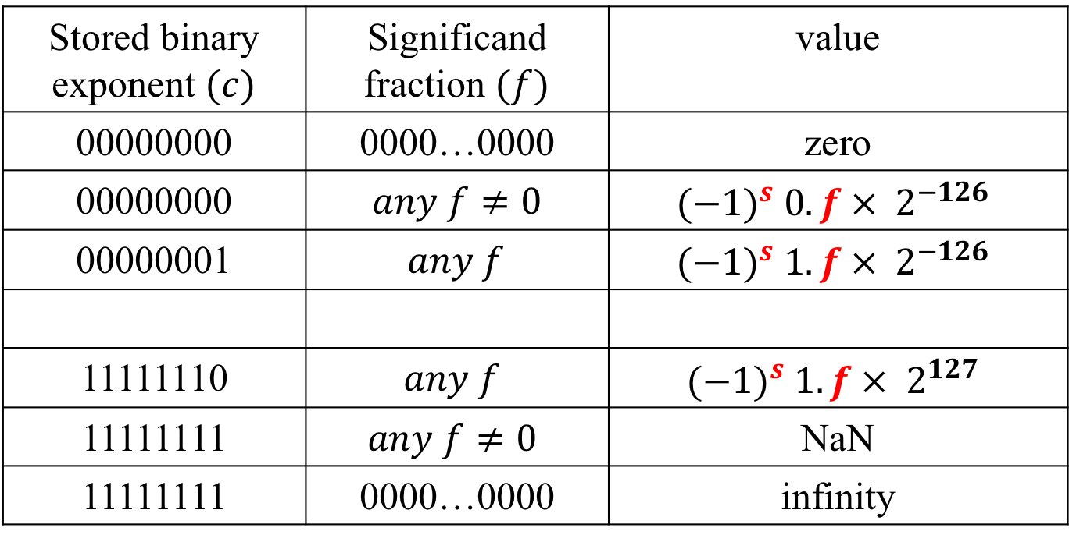
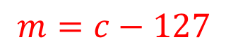

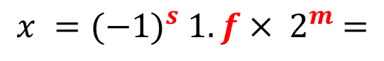

Summary for Single Precision
$$x ={(−1)}^{s} 1.f ×{ 2}^{m} =$$
$$s$$
$$c$$
$$f$$
$$m=c−127$$
Stored binary exponent $(c)$ | Significand fraction $(f)$ | value
00000000 | 0000…0000 | zero
00000000 | $any f≠0$ | $${(−1)}^{s} 0.f ×{ 2}^{−126}$$
00000001 | $$any f$$ | $${(−1)}^{s} 1.f ×{ 2}^{−126}$$
11111110 | $$any f$$ | $${(−1)}^{s} 1.f ×{ 2}^{127}$$
11111111 | $$any f≠0$$ | NaN
11111111 | 0000…0000 | infinity
$$⋮$$
$$⋮$$
$$⋮$$

